Slide 1

Research on Customer Personality Analysis
DSC680
Sharath Chandra Tummanapally
July 2, 2022

Slide 2

Business Problem
Is it possible for a company to develop its business by researching the personality of its ideal customers?

Slide 3
Background/History
An organization can adjust its product based on the target customers from various customer segments by using Customer Personality Analysis. For instance, a business can determine which client segment is most likely to purchase the product and then focus its marketing efforts only on that group of customers, as opposed to spending money to advertise a new product to every customer in its database.

Slide 4
Data Source/Dataset
The dataset I retrieved is from an online source Kaggle, where it provides the attributes of the Customers, Companies products details, Promotions offers by the company and the mode of purchases by the customers. The dataset contains each individual customer and with respective provide data, number of purchases etc. We will get through the data in detailed as we dig deep into data and clean it for our analysis.
Source: https://www.kaggle.com/datasets/imakash3011/customer-personality-analysis?datasetId=1546318

Slide 5
Data Exploration
Steps :
Identified unwanted columns and deleting them from data frame.
Added new useful features.
Transformed features, I have converted the data frame columns to appropriate datatypes.
And finally, verified the missing data and updated null values to zeros.
Thus, we have a refined dataframe.

Slide 6
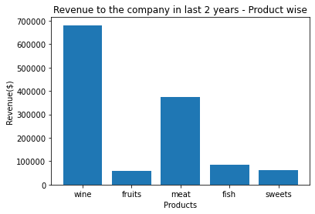
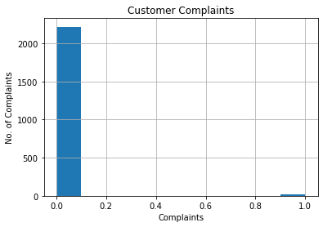
Visualizations
Graph I
Graph II

Slide 7
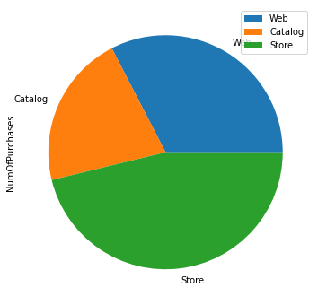
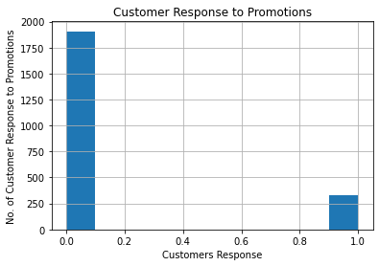
Visualizations
Graph III
Graph IV

Slide 8
Building and Evaluating Model
I used the Multi Linear Regression model. In our dataset, we have multiple features that are interdependent. Multiple Linear Regression (MLR) basically indicates that we will be having many input features and one output feature.
I chose the Predictor (Income, Age and NumPurchases)and Target (MntTotal) columns. Then split the data into training and testing sets for the model.
I applied the model on training data.
I calculated the accuracy score.
Also, calculated the metrics - R2, RMSE and MAE.

Slide 9
Conclusion
Here, we collect data, comprehend and pay attention to what matters in the data, and then build a model to acquire a better understanding and make predictions.
Going back to our model I built for this, after analyzing it, I would recommend implementation because the model does perform well, and it has the accuracy around 75%.
This also signifies the importance of understanding the customer’s attributes like their purchases, income or location which can further provide a helpful insight to a company that implement this solution.
We can improve the model by using it in more datasets that are on the customer purchases across different demographics and refine the model.

Slide 10
Questions/answers
What are the limitations of this research?
The total amount spent on products were missing, I had to add it for the model. Also, The data is limited to few customers. More data would have given us more information on Correlation of variables.
What are the Challenges faced in this research?
I had raw dataset and it was a bit challenging to identify the columns that are dependent and independent.
How can we implement this in future businesses?
This model could work for retail business and e-commerce businesses where understanding the customer’s personality is a huge factor to improve their businesses and grow revenue.

Slide 11
Thank You!!

